Slide 1


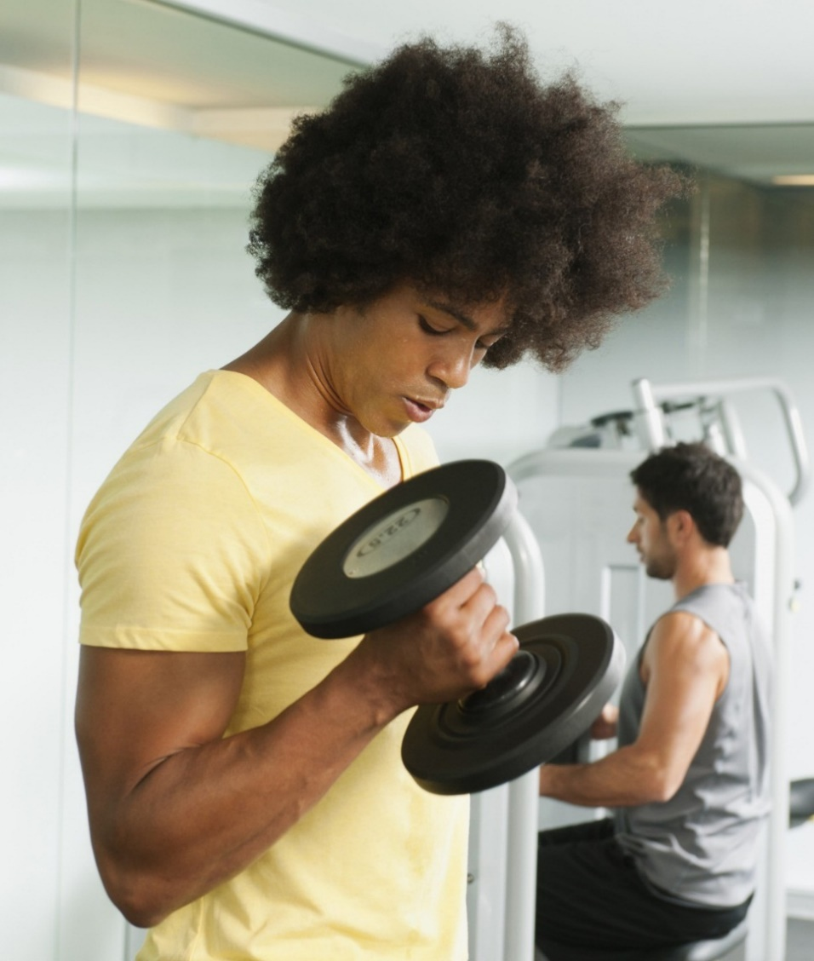
MUSCLEHUB A/B TEST RESULTS
Notes:
Title

Slide 2
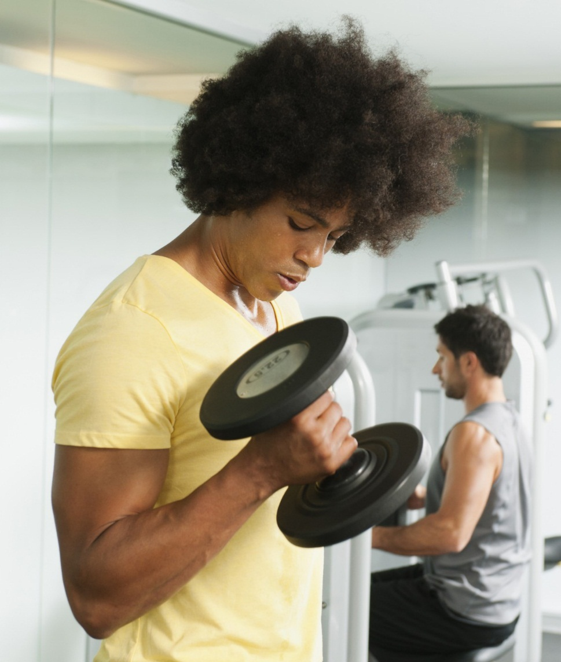
THE brief
Determine if the MuscleHub fitness test intimidates some prospective members.
Notes:
The objective of this presentation is to present results from an A/B test to determine whether taking a fitness test as part of the MuscleHub membership process is more or less likely to put people off signing-up.

Slide 3
THE 3-STAGE musclehub membership process
Take a fitness test with a Personal Trainer
Fill out an application form for the gym
Pay for the first month’s membership
Notes:
The current MuscleHub membership process involves: (1) taking a fitness test with a PT; (2) completing an application form; (3) paying for the first month’s membership

Slide 4
A/B TEST PARAMETERS
Take a fitness test with a Personal Trainer
Fill out an application form for the gym
Pay for the first month’s membership
GROUP A
Fill out an application form for the gym
Pay for the first month’s membership
GROUP B
Notes:
The A/B test splits visitors to the gym into two Groups; members of Group A completed the fitness test as per the current membership process whereas members of Group B proceeded straight to the application stage and did not take a fitness test.

Slide 5
A/B TEST HYPOTHESIS
visitors THAT skip the fitness test (GROUP B) will be more likely to purchase a membership to MuscleHub
Notes:
The MuscleHub Manager, Janet, believes that visitors who proceed straight to the application stage and skip the fitness test are more likely to complete the membership process (i.e. those in Group B).

Slide 6
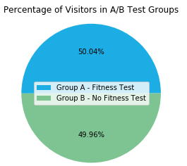
A/B TEST results - quantitative analysis
VISITORS BREAKDOWN:
5,004 visitors participated in the test
2,504 visitors took a fitness test (Group A)
2,500 visitors skipped the test (Group B)
575 visitors completed an application
450 visitors purchased a membership
Notes:
5,004 visitors took part in the A/B test and were fairly evenly split between the two participation groups, with 2,504 undergoing the fitness test and 2,500 skipping them. From all test participants, a total of 575 individuals completed applications and, of these, 450 went on to purchase membership.

Slide 7
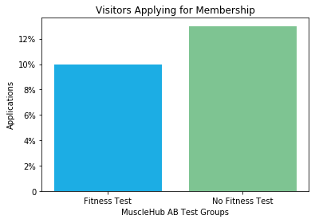
A/B TEST results - quantitative analysis
APPLICATIONS
Just under 10% of visitors from Group A applied for membership following their fitness test (250 people)
Exactly 13% of visitors from Group B applied for membership without having a fitness test (325 people)
Notes:
Results from the A/B test show a significant difference in the percentage of visitors from each group who went on to complete an application, with just under 10% of Group A doing so having undertaken a fitness test and 13% of Group B doing so having skipped the fitness test.

Slide 8
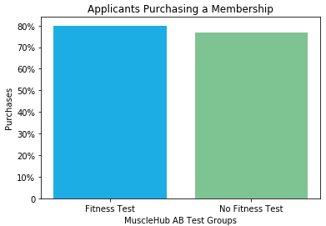
A/B TEST results - quantitative analysis
A/B TEST RESULTS – APPLICANT PURCHASES
There was very little difference in the percentage of applicants from each group who went on to purchase a membership having completed an application
Notes:
The A/B test results show no significant difference in the percentage of each group purchasing a membership having completed an application, so skipping the fitness test does not appear to have significantly affected this part of the membership process.

Slide 9
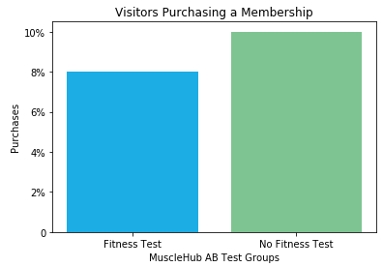
A/B TEST results - quantitative analysis
A/B TEST RESULTS – VISITOR PURCHASES
Overall, a greater percentage of visitors went on to purchase a membership from Group B (10%) than Group A (7.99%)
Notes:
The overall results of the A/B test indicate a significant difference in the percentage of visitors purchasing a membership having skipped the fitness test (10%) than those who undertook the test (7.99%).

Slide 10
A/B TEST results - Qualitative analysis
“I tried to sign up for LiftCity last year, but the fitness test was way too intense.”
A/B TEST RESULTS – VISITOR TESTIMONIALS:
Cora enjoyed the fitness test and signed-up (Group A).
Jesse had previous bad experience of the LiftCity fitness test; she did not have to deal with the Personal Trainers at MuscleHub however her reasons for not signing-up were entirely unrelated (Group B).
Sonny took the fitness test but did not enjoy it (Group A).
Shirly had previous bad experience of the LiftCity fitness test but didn’t take the test at MuscleHub as she was signed-up in a matter of minutes (Group B).
“Down at LiftCity they had me doing burpees 30 seconds after I walked in the door”
Notes:
All four individuals interviewed mentioned fitness tests which suggests they are influential in the membership decision making process, and three out of four either didn’t enjoy the test or had bad experiences of fitness tests at another gym chain. On balance, the qualitative analysis suggests an association between fitness tests and negative sentiment.

Slide 11
recommendation
Results from the A/B test suggest that the fitness test should be removed from the MuscleHub membership process, to increase the number of visitors who go on to purchase a membership.
Notes:
Quantitative and qualitative results from the A/B test support Janet’s hypothesis that the fitness test may be intimidating to some visitors, putting them off from completing the membership process and costing MuscleHub valuable business. The recommendation from the Data Analyst is that the fitness test is either removed altogether or at least made optional.

